Slide 1
Building Reading Comprehension in Adults
Part 2: Using Reading Strategies

Slide 2
Overview
Day 1:
Literacy: Where we’re going
Planning instruction using ABCD
Day 2:
Review and practice with Day 1 content
Reading strategies
Day 3:
Higher-order thinking
Facilitating discussion

Slide 3
Review and Practice with Day 1
What is the ABCD?
What are some good ways to do “A” and “B”?
What are some things NOT to do for “A” and “B”?
For “C”, what are good words to teach?
For “C”, what are the two different ways to teach a word? How do you decide which it is?
For “deep”, what are the steps you follow?

Slide 4
ABCD Prereading Process
Four simple steps to success
Activate prior knowledge
Build background
Concentrate on vocabulary
Describe purpose for reading

Slide 5
Activating Prior Knowledge: Best Practices
DO:
Relate the text to students’ lives
“Sell” the text
Link to recent learning (especially if themed)
Make it quick (5 minutes)
Have students share their knowledge with each other
DO NOT:
Spend a long time on this
Ask students to tell you what they know when it’s clear they know very little

Slide 6
Build Background
Before reading, provide information you don’t expect your students to know and will make the reading easier
Take this time to
Build interest
Relate to students
Use
video clips
images
maps
discussion and short “lecture”

Slide 7
Do this:
Plan carefully (choose content and figure out how to engage students in it)
Make it snappy
Be direct, simple, clear, and excited
Get students talking and discussing
Not this:
Spend all your time finding the content (organizationally plan)
Take a long time (5 minutes is probably good)
Use images/videos/graphics mostly because they are fun and not because they are useful … best if they are both!
Get fancy

Slide 8
Concentrate on vocabulary: Choosing words to teach
Is the word useful?
In this particular text?
Low frequency (i.e., Tier 3) words must be taught for certain texts
Science and social studies texts often have many of these words
In general?
Academic words (i.e., Tier 2) that will benefit students are good to teach
Is this a word my students know?
Students sometimes don’t know words we expect they will know (i.e., Tier 1 words)!
If you think students might not know a word, teach it
Words should be “Goldilocks words” (Baumann & Kame’enui, 2004)... Not too easy, not too hard.

Slide 9
Think of two types of words
Type #1 ... Deep instruction words
You want to teach these thoroughly because they are central to understanding the text
Very important (in this story)
and/or
Very useful (in general)
Type #2 ... Quick instruction words
You want to make sure students are familiar with them
Somewhat important in this story (they will be confusing if students do not know them)

Slide 10
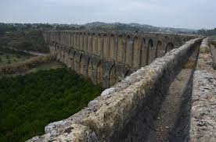
Teach some words quickly
Highly imageable words students may need should be taught quickly and simply
Long discussions of them are not needed
aqueduct
a structure to carry water from place to place, like an open pipe

Slide 11
What does it mean to teach words deeply?
This instruction takes more time
The teaching sequence takes longer
You provide multiple examples
You practice word meanings
You assure multiple exposures
Students review words many times across instructional unit
This is the model advocated by Beck, McKeown, and colleagues
You should choose this strategy with very important, useful words
Because this is so intensive, limit the number of words to just a few (3 to 5) per week

Slide 12
How to provide deep instruction
Provide a clear, simple definition
Synonyms are best, if they are a good fit
Use a picture to help students understand word
Do this only if it really fits!
A flag is not a good picture for patriotism
Elaborate on definition
Examples
Non-examples
Sentence
Group practice
Review word in text and afterwards

Slide 13
Vocabulary: Before, During, After?
Great discussion!
Before, during, and after
With before, comment in your examples about the use of the word in the text you’re reading
Note from Ngaio:
There was an interesting discussion among the teachers about whether it makes sense to look at the text, in an effort to provide context, before addressing vocabulary. They were divided and have different approaches to this. Some teach the vocab in isolation before. Others go through the text, identify unfamiliar words, go over them, then revisit the text.

Slide 14
Describe the purpose for reading
Remind the students why this might be interesting
Link to their experiences, back to your activation of prior knowledge
Give hints about what students should focus on
Make clear how they will use the information later
Many of you said Trajan was a great Roman emperor. As we read about Hadrian today, pay attention to his different accomplishments. When we’re finished reading, we’ll discuss whether Trajan or Hadrian was a better emperor.

Slide 15
Homework: How did it go?
Note from Ngaio:
Some of the teachers have already tried implementing the pre-reading activities and commented that the prep is exceedingly time consuming, which you mentioned during the sessions – (time spent crafting sentences and questions for activating prior knowledge).
First, good work!
Second, yes
How can we shorten things up?
Don’t spend too much time on activating prior knowledge
Focus more on building background and especially vocabulary
When you plan, just write your first ideas and keep going without working too long on any one part
Go back and refine if you have the time

Slide 16
High-Value Strategies

Slide 17
What is the value of strategies?
Why teach strategies?
As an alternative, we could just build representations of specific texts… why not do that?

Slide 18
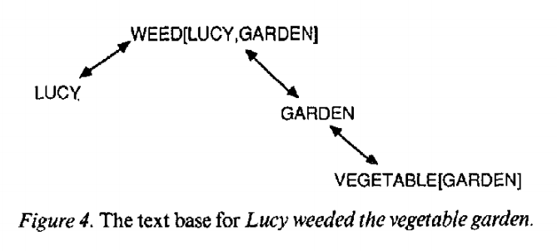
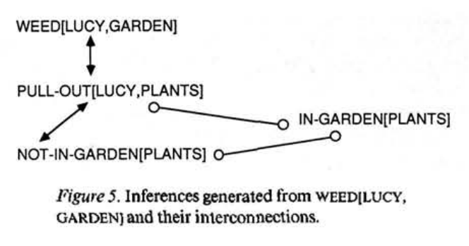
What does “improving reading comprehension” mean?
Building mental representations of texts
Simple connections among parts
Complex and inferred ideas
Kintsch (1988)

Slide 19
High-Value Strategies
Monitoring and Clarifying
Summarizing
Asking and answering questions
Also for non-fiction (not covered today):
Identifying text structure

Slide 20
Monitoring and Clarifying
ReTaPE
Reread the sentence (aloud)
Talk about each part (aloud)
Put the pieces together
Explain the sentence again

Slide 21
ReTAPE for The Wine Shop
Model
Paragraph 2:
The rough, irregular stones of the street, pointing every way, and designed, one might have thought, expressly to lame all living creatures that approached them, had dammed it into little pools; these were surrounded, each by its own jostling group or crowd, according to its size.
Paragraph 2:
others devoted themselves to the sodden and lee-dyed pieces of the cask, licking, and even champing the moister wine-rotted fragments with eager relish.
Paragraph 3:
There was no drainage to carry off the wine, and not only did it all get taken up, but so much mud got taken up along with it, that there might have been a scavenger in the street, if anybody acquainted with it could have believed in such a miraculous presence.
Model
Together

Slide 22
ReTaPE for The Mail
In pairs

Slide 23
Getting the Gist

Slide 24
Summarizing
Sharing your representation of the text:
Sentence
Paragraph
Page
Chapter
Book
Approaches:
Paragraph Shrinking (Fuchs, Fuchs, Mathes, & Simmons, 1997)
Getting the Gist (Klingner & Vaughn, 1998)

Slide 25
Steps to Get the Gist
Name the most important who or what
Tell the most important thing about the who or what
Write/say a main idea statement in 10 words or less

Slide 26
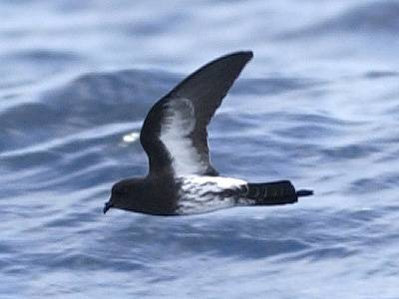
SEABIRDS
Model
A seabird is any bird that spends most of its time at sea and depends on the sea and its islands for all its basic needs. The sea provides food and its remote islands and rocky outcroppings provide safe nesting and resting places. For 60 million years, these highly specialized, diverse birds have adapted to life on the world’s vast oceans.

Slide 27
GET THE GIST: SEABIRDS
Who or what:
Seabirds
Important information:
Seabirds spend most of their time at sea.
Seabirds depend on the sea and its islands for their basic needs.
The sea provides food and resting and nesting places.
Write the gist in 10 words or less:
Seabirds get what they need from the sea.
Seabirds depend on the sea for everything they need.

Slide 28
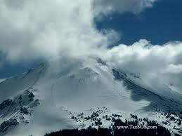
MOUNT LASSEN
Practice
Mount Lassen went off with a bang. The California volcano erupted in a series of explosions between 1914 and 1917. It threw out tons of hot ash, boulders, and melted rock called lava. The boiling lava melted the snow at the top of Mount Lassen. It made the earth beneath the snow turn into mud. The thick mud flowed down the mountainside like a river. It mowed down miles of trees in its path and filled meadows with up to 20 feet of mud.

Slide 29
GET THE GIST: MOUNT LASSEN
Who or what:
Mount Lassen
Important information:
The volcano erupted.
It threw out hot ash, boulders, and lava.
The earth beneath the snow turned to mud.
The mud flowed down the mountainside.
The mud mowed down trees and filled the meadows.
Write the gist in 10 words or less.
Mount Lassen erupted and caused damage.

Slide 30
Practice together
Pride and Prejudice
Name the most important who or what.
Mr. Bennet’s wife
Tell the most important thing about the who or what
Mr. Bennett’s wife insisted on telling Mr. Bennett that Netherfield Park had finally been rented to someone.
Say a main idea statement in 10 words or less.
Mr. Bennett’s wife told him that someone had rented Netherfield Park.

Slide 31
Practice: Write your own gists for the next two paragraphs

Slide 32
Asking and Answering Questions
Build students’ representations of specific texts

Slide 33
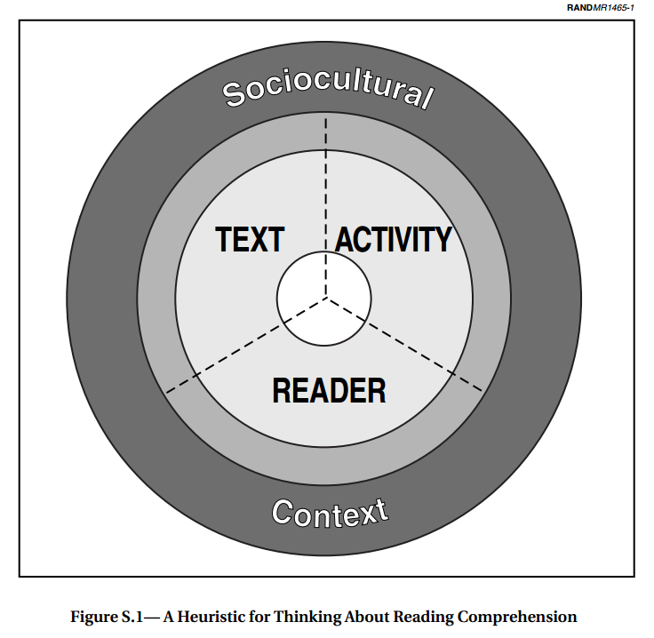
What are Question-Answer Relationships?
Knowing what the question asks (the activity) and knowing how to use the text and the reader’s own background knowledge to answer it
Not all questions require equal
Reader background knowledge
Text information
Raphael (1986); Snow (2002)

Slide 34
QARs you should teach
Reader
Text
The Author and You
Right There
Think and Search
Higher is not “better”
If the text-focused questions cannot be answered, the reader-focused questions cannot be answered.

Slide 35
Right There Questions
Literal questions, usually found in a single sentence.
Many of the words in the question are in the text
Where did Monseigneur hold his fortnightly reception?
What was Monseigneur about to do?
You come up with one!

Slide 36
Think and Search
Draw conclusions (make inferences) from text
Integrate information from more than one place in the text
(Answers may require multiple sentences)
What can we infer about Monseigneur’s way of life?
How did Monseigneur use four men to help him with his chocolate?
You come up with one!

Slide 37
Author and You
Connect information in the text with outside experiences and opinions
Text-to-self connections, text-to-text connections, text-to-world connections
How does Monseigneur’s way of life compare with the lives of wealthy people today?
What is your emotional reaction to this text? What causes that?
You come up with one!

Slide 38
What Question Do I Ask When? (Archer & Hughes, 2011)
Question Type | Purpose of Questions | When to Ask? | Response Modality | Response Length
Right There | Do students understand the basic structure? | During reading After reading | Individual oral, choral | A word, a phrase, or a sentence; 2-10 seconds
Think and Search | Are students making important inferences within the text? | During reading After reading | Turn-and-talk; small groups; written | Two or three sentences; 10-60 seconds
Author and You | Do the students see how this text relates to them, other texts, or our world? | After reading | Small groups; written; homework | Three or more sentences; 30-120 seconds

Slide 39
Know WHY you are asking a question
What was Monseigneur about to do?
The phrase “take his chocolate” is critical to know and use
Focus on your CONTENT OBJECTIVE
What can we infer about Monseigneur’s way of life?
Understanding the nature of the indulgence helps you understand the larger theme.

Slide 40
Key Considerations
Different questions for different purposes
Focus on your
Plan (script) your questions.
Make sure the question language is clear
Answer the question yourself: Will your students be able to give the answer you would like?
Determine how you will elicit responses.
Whole group response? (choral)
Individual response? (teacher-student)
Turn-and-talk? (pairs)
Think-pair-share? (student + pairs + teacher-student)
Provide ample wait time. … 3 seconds at least

